Slide 1
Release 2 Presentation
Pinelands Music School

Slide 2
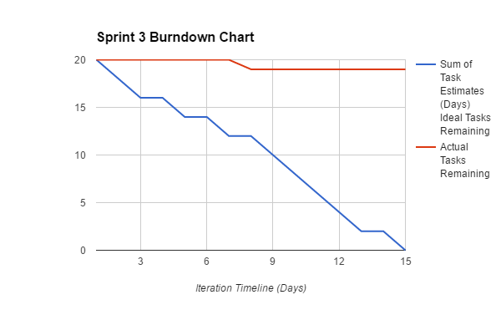
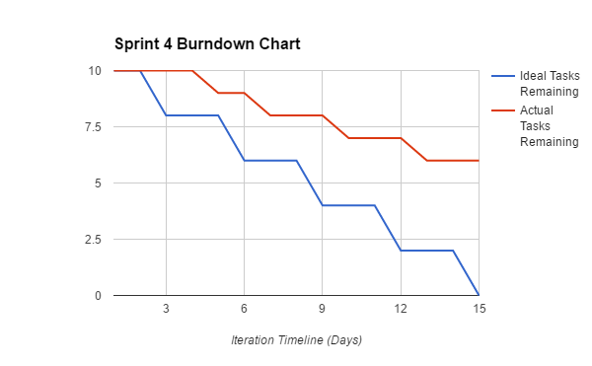
Sprint Burndown Charts

Slide 3
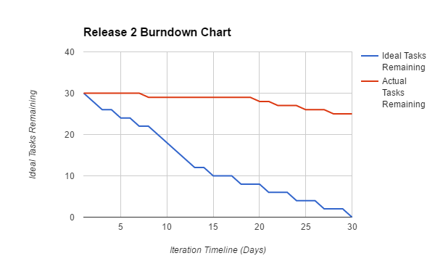
Release 2 Burndown Chart

Slide 4
User Stories
Completed - Sprint 3
Story ID | Story Title | Story Points | Completed
S1 | Access Class Timetable | 2 | 0
S5 | Enrol in Classes | 2 | 1
S4 | Reschedule Classes | 1 | 0
S11 | View Class Schedules | 1 | 0
S28 | View Student Schedules | 2 | 0
S30 | Alter Student Schedule | 2 | 0
S29 | Roster Teachers | 1 | 0
S6 | Search Available Classes | 2 | 0
S11 | View Class Schedules | 1 | 0
S1 | Access Class Timetable | 2 | 0
S4 | Reschedule Classes | 1 | 0
S11 | View Class Schedules | 1 | 0
S12 | View Student Enrolments | 1 | 0
S14 | View Students by Class | 1 | 0
 | Story Point Sub-Total | 20 | 1

Slide 5
User Stories
Completed - Sprint 4
Story ID | Story Title | Story Points | Completed
S21 | View Enrolment Statistics | 1 | 0
S10 | View Staff Roster | 1 | 0
S12 | View Student Enrolments | 1 | 0
S27 | Read Customer Feedback | 2 | 2
S20 | View Submitted Complaints | 1 | 1
S21 | View Enrolment Statistics | 1 | 1
S27 | Read Customer Feedback | 2 | 2
S23 | Monitor Music Interest | 1 | 0
 | Story Point Sub-Total: | 10 | 4

Slide 6
Functionality beyond scope
Domain registration:
https://www.pinelandsmusicschool.com/team81
Social Media Presence:
https://www.facebook.com/pinelandsmusicschool
https://www.facebook.com/events/1414967581865629/

Slide 7
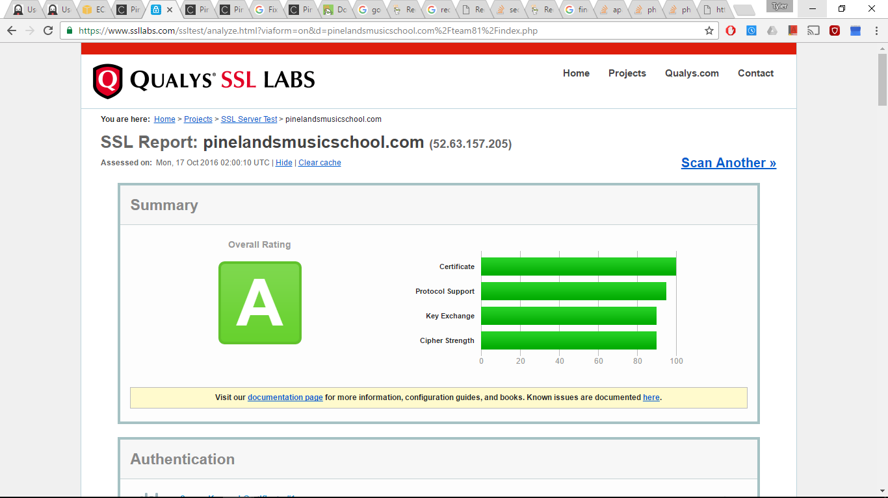
Security testing

Slide 8
Features for future development
Implement class booking system
Teacher Additional Training
Track progress of teacher’s skillsets
Monitor Music Interest
Monitor Annual Report
View Revenue Report
Online Communication
Remote File Access
Instrument Hire through site
View Inventory Database

